Slide 1


EGSC Information Session
September 4, 2009

Slide 2
Outline
EGSC Background
Structure of the Council
What we have done
What we plan to do
Your next steps

Slide 3
Background
EGSC’s main goals are to represent the interests of the graduate engineering students at Columbia and to build a sense of community and friendship among graduate engineering students.
We do this by:
  Organizing social events
  Funding student clubs and organizations
  Representing student interests to the administration
  Improving the quality of student life at Columbia

Slide 4
EGSC Structure
SEAS Students (you)
Department representatives (possibly you)
Executive Board
Council
Committees
Administration
Other Councils
Alumni
Student Clubs
Social Events
Senate

Slide 5
EGSC Executive Board
President
Timur Dykhne
Vice President
Can Savasan
Academic Affairs Committee
Treasurer
Mitch Morris
Budget Committee
Secretary
Arseniy Kukanov
Administrative Committee
Social Chair
Sriharsha Aradhya
Events Committee
Alumni Chair
Rob van Haaren
Career Committee
Interschool Chair
Kshitij Yadav
Interschool Committee

Slide 6
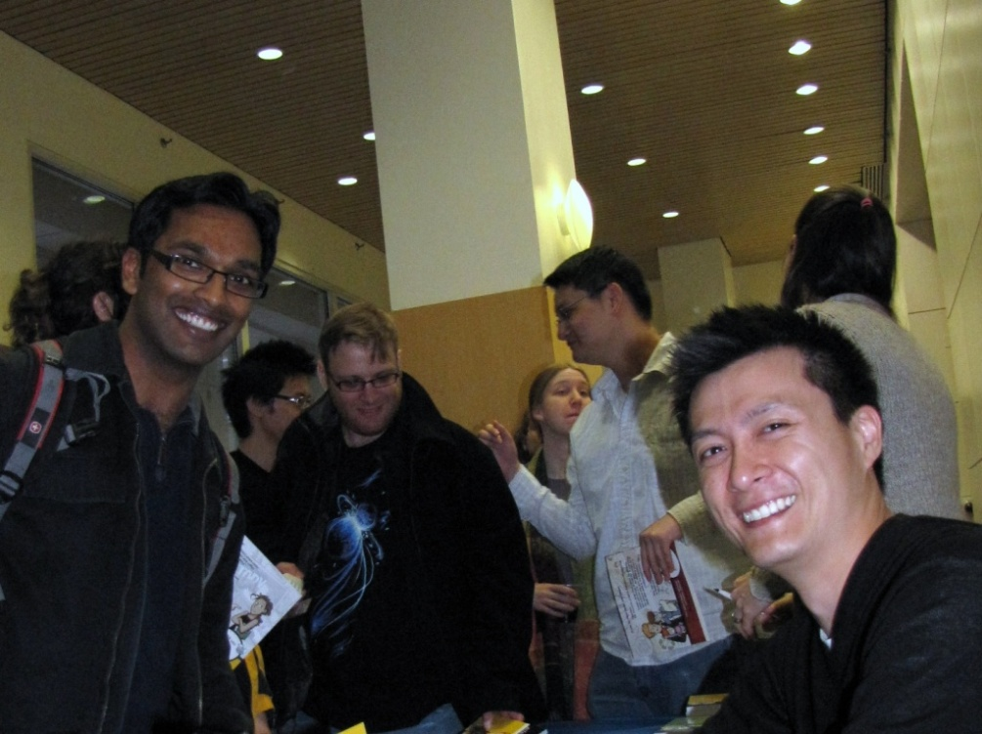
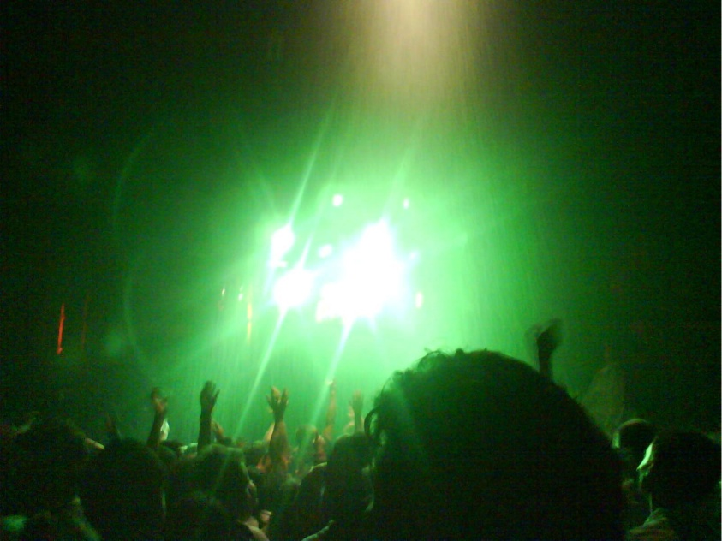
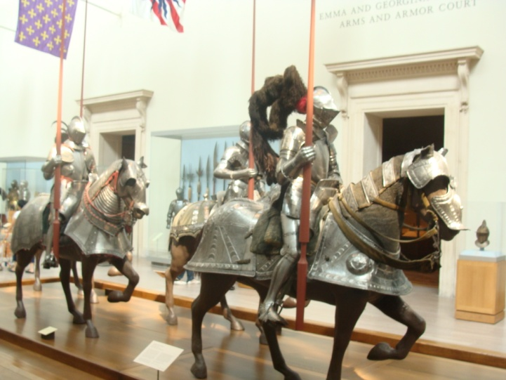
What We Have Done
Social events
  Movie nights
  Happy Hours
  PhD Comics
  Museum tour
  Sport events
  Study breaks
  Shows

Slide 7

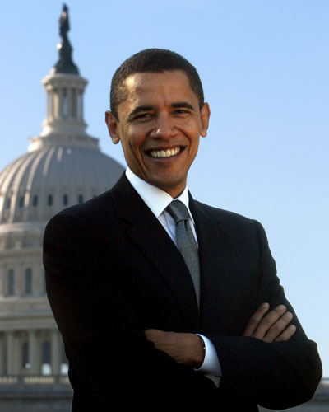

What We Have Done
University wide
  Energy saving initiative
  Carleton cafeteria
  Athletics events
  Academic talks
  NYCares
  House wares exchange

Slide 8
What We Plan to Do
More socializing, more happy hours, more fun!
  Ski trip
  Graduation party
Alumni mixers, networking events
Collaboration with CCE
Improving quality of life
  Book exchange
  Carleton lounge
  Conversation with the Dean
Funding student clubs
  SETI

Slide 9
What We Plan to Do
Basically…
Anything you want!

Slide 10
Openings
Department Representatives (2 per department)
  Applications due September 22
  Short questionnaire
  Ten signatures (not all yours)
Senator
  Representative of the School of Engineering to the entire University community
  Two senators for the entire School (grad and undergrad)
  Election in the end of September
  Only one seat available this year

Slide 11
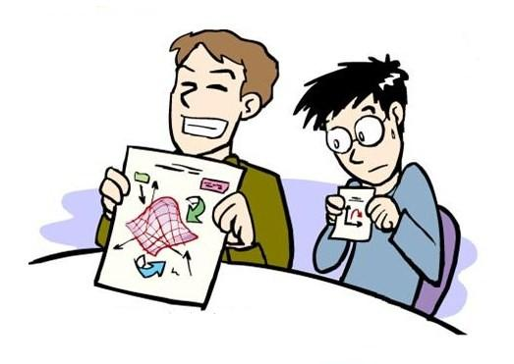
Responsibilities
Attend regular meetings on Wednesdays at 7PM
Join at least one committee
Be active!

Slide 12
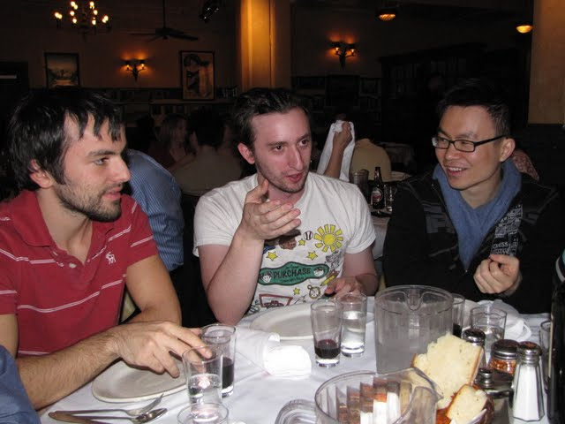
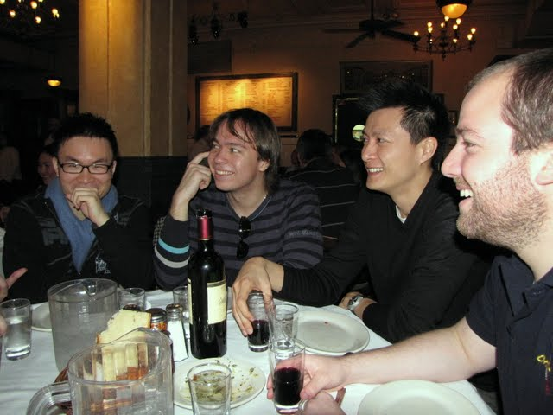
Why join EGSC?
Meet people and make friends
  Council Dinner
  Reach people outside your School
Do the things you want to do
  We are very informal!
Connections to Alumni
  Archimedes Society
Access to Administration

Slide 13
Thank You

